Slide 1
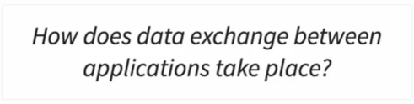
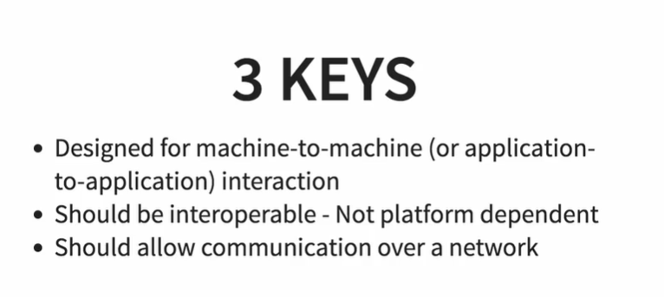
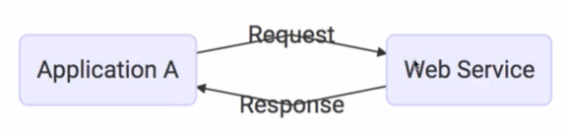
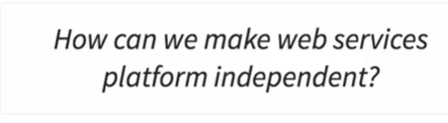
What is web services
We can make web service platform independent using below data exchange format
Using this format we can communicate between application developed in PHP, .Net , Java or in any language
XML
JSON

Slide 2
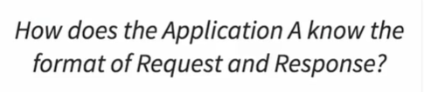
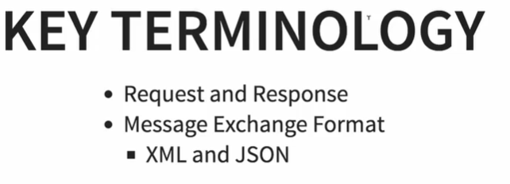
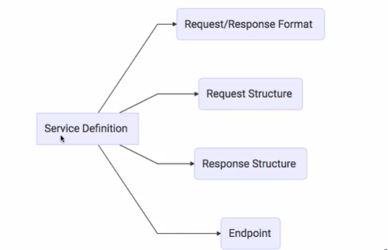
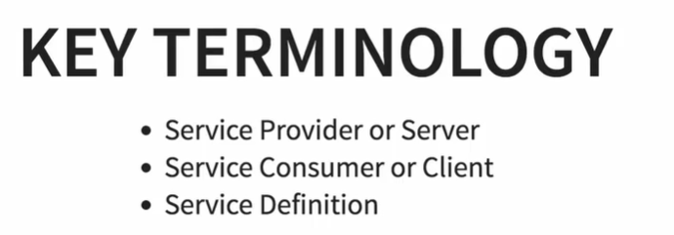

Using service definition we can mention some information

Slide 3
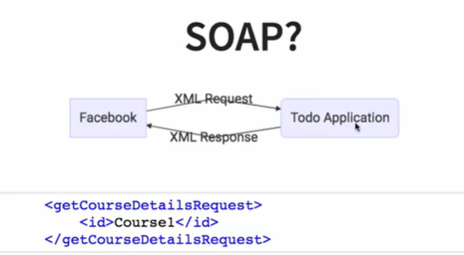
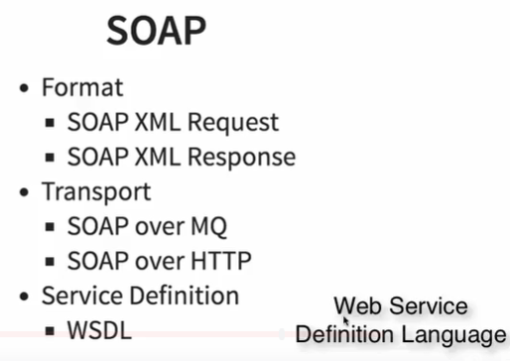
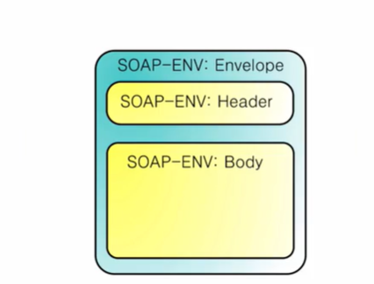
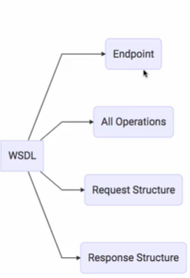

Slide 4

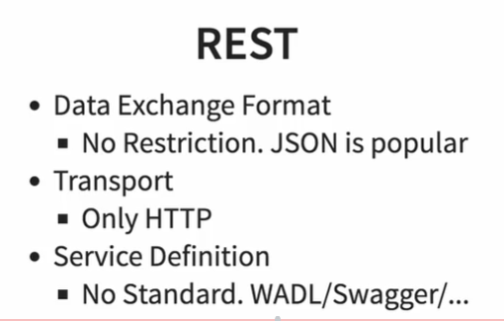
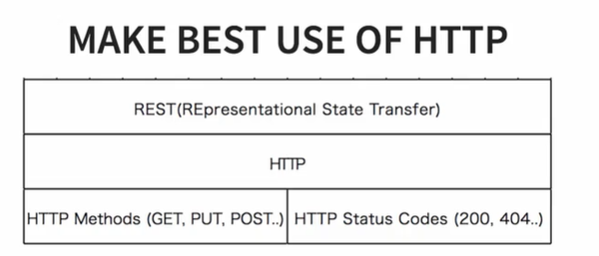
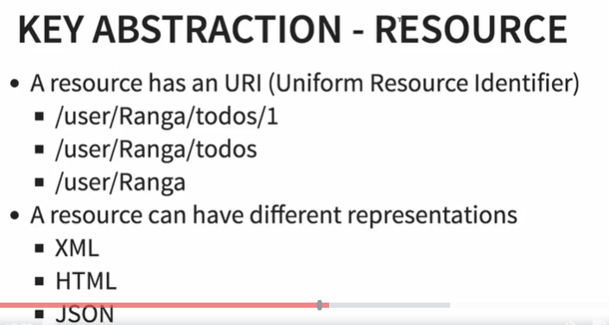
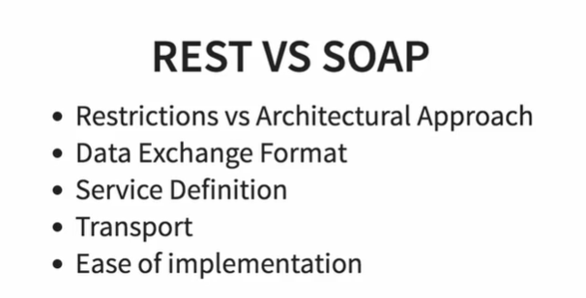
REST
Rest Vs SOAP

Slide 5
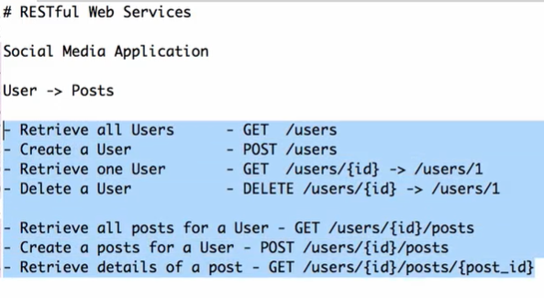
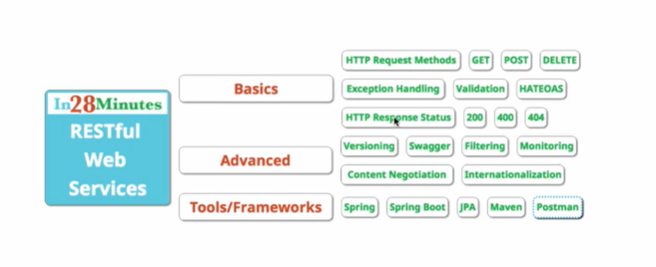
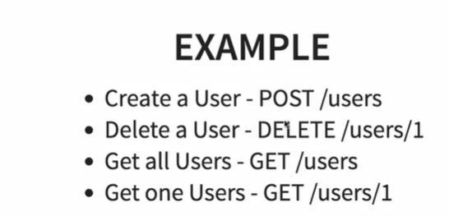
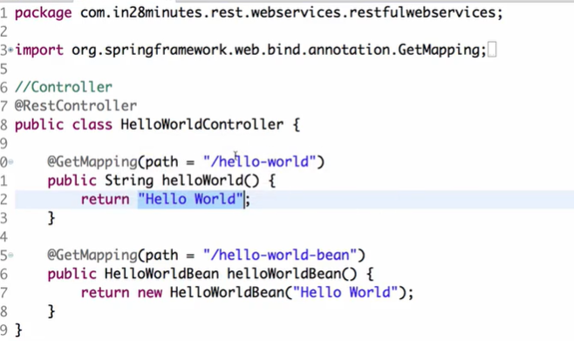
Restful Services
This will return data in json format
{
Message=“Hello World”
}

Slide 6
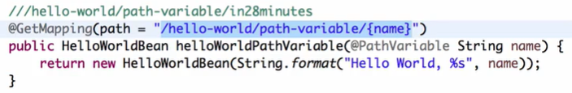
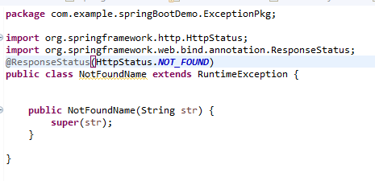
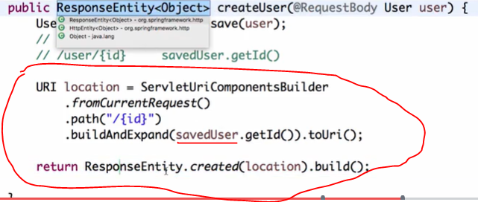
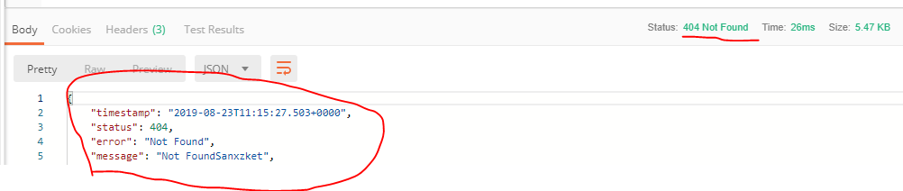
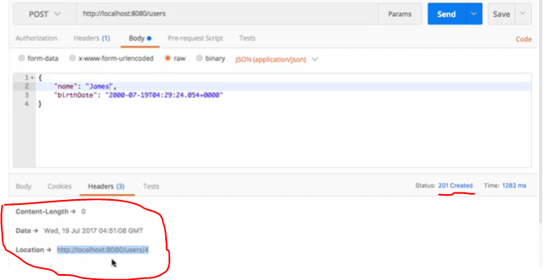
Output
Output

Slide 7
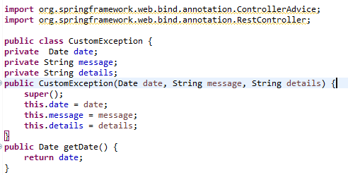
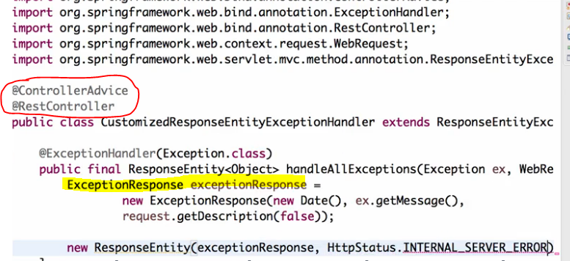
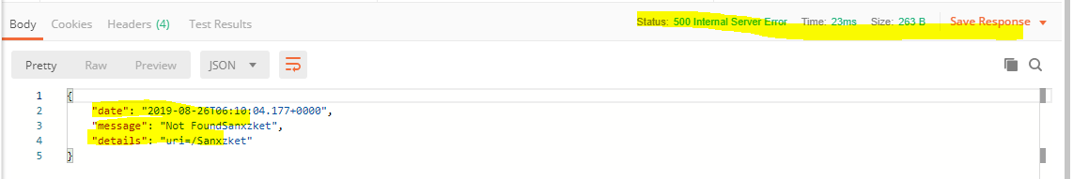
Implementing Generic Exception Handling for all Resources
We have created ExceptionResponse class
@ControllerAdvice will apply this custom exceptions on all controller classes
Need to extends ResponseEntityExceptionHandler

Slide 8
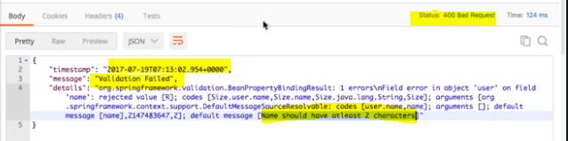
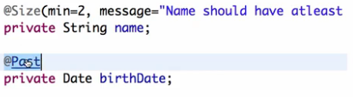
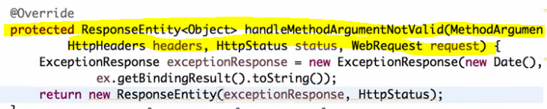
Implementing Validations for RESTful Services
Step1 Apply annotation @Valid in controller class method
Output
Step2 Apply validation using annotation in POJO Class od User
Step3 Override method handleMethodArgumentNotValid in CustomException class which we have created

Slide 9
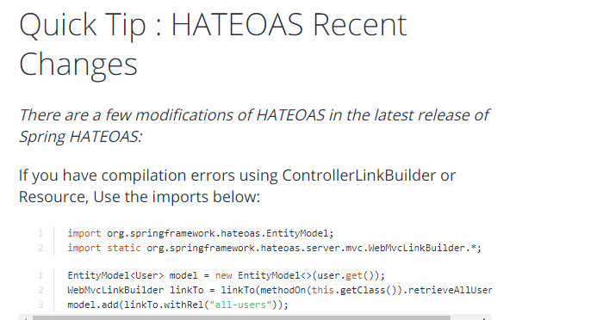
Implementing HATEOAS for RESTful Services

Slide 10
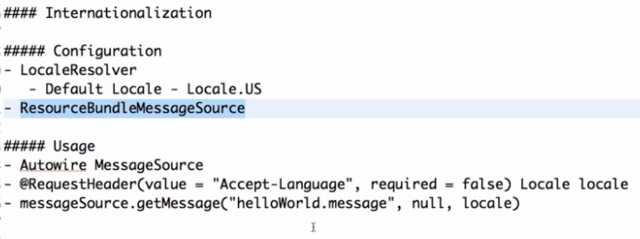
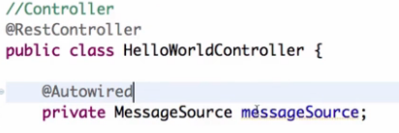
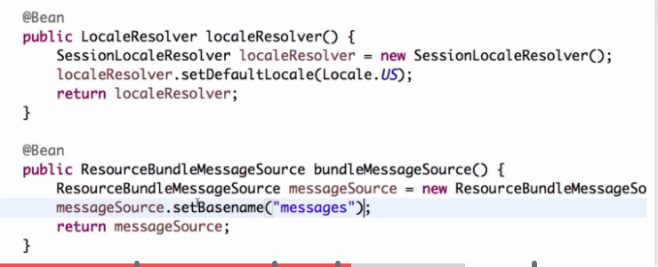
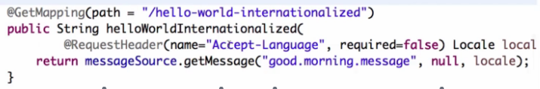
Internationalization for RESTful Services
Step2 Create two properties file in resources package
Step 3 Create bean for messageSource in controller class
Step 1 Create two bean in the main class
Step4 Create GET method in controller like below

Slide 11
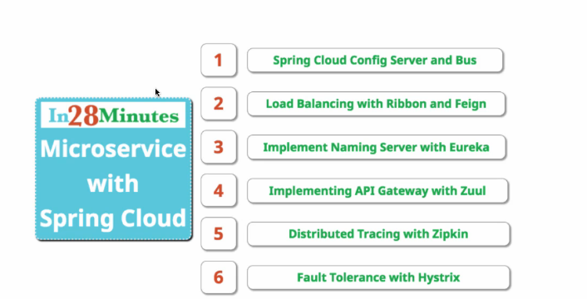
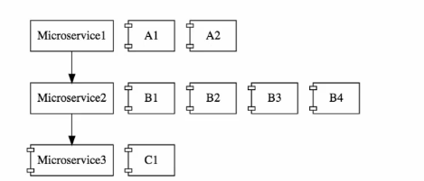
Microservices using spring cloude
Microservices- Instead of developing a one big monolith application we can develop multiple small microservises.
In above example we have splited application in 5 microservices. We can split it in to 5,10, 25 microservises
This could be cloud enabled.
We can create multiple instance of one microservice as shown below
Cloud enble means if on microservices has more load we can bring another instance to handle the load

Slide 12
Challenges with Microservices
Bounded context- it challenging to decide the boundaries.
2. Configuratuion management- as there could be multiple instances of one microservice, we should needs more efforts to manage it.
3. Dynamic scale up and scale down- Some time we need 2 instance of the microservices and some time we need 10 instances of microservices. So it difficult to scale up and scale down as well as to distribute the load among the multiple instances at a runtime.
4. visibility- Its difficult to find bug from multiple microservices. As it generate log at in only on place.
5. Pack of the card- If one microservice get fails it could cause to fails all other microservices. It is must to have fault tolerance in micro services.

Slide 13
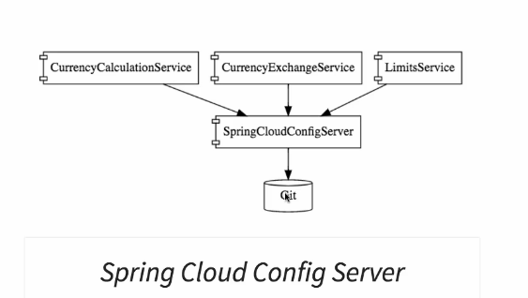
Introduction to spring cloud
Spring Cloud provides tools for developers to quickly build some of the common patterns in distributed systems (e.g. configuration management, service discovery, circuit breakers, intelligent routing, micro-proxy, control bus, one-time tokens, global locks, leadership election, distributed sessions, cluster state). Coordination of distributed systems leads to boiler plate patterns, and using Spring Cloud developers can quickly stand up services and applications that implement those patterns. They will work well in any distributed environment, including the developer’s own laptop, bare metal data centres, and managed platforms such as Cloud Foundry.
- There are multiple projects which provide solution for microservices challenges
Projects from Spring cloud provides solutions to challenges
Configuration management – Spring cloud config server provide environment to store configuration for multiple microservices. This project uses git to store there configuration and expose this configuration for all microservices.

Slide 14
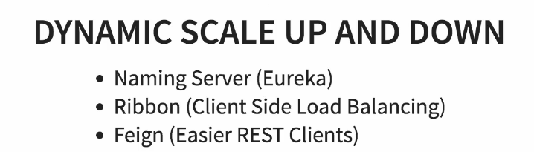
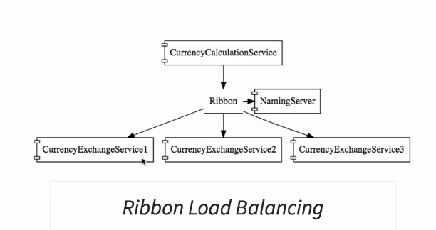
2. Dynamic scale up and scale down
There are different project are used for dynamic scale up and scale down
Naming server- used to register new microservices . Also it maintain the instances for the microservices. Microservices can ask naming server to give current instances of microservices.
Ribbon- ribbon are used to balance load at client side.
Ribbon makes sure the load has been distributed among the all instances of the microservices that gets from naming server.
3. Feign- Are used to create simple RESTfull client.

Slide 15
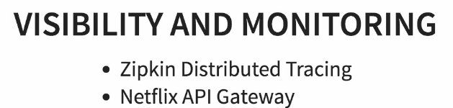

3. Visibility and monitoring
Zipkin distributed tracing- are used to trace requests
We are using spring cloud south to assign id to the request among the multiple component and we are using Zipkin distributed tracing server to trace the request among the multiple component.
2. Netflix API gateway- The multiple microservices can have common features like login, security, analytics.
- We not need to ad this common features in all services.
- Netflix API gateway provides great feature to avoid this challenges
- We can use Netflix zool api getway for this
Fault tolerance
Hystrix- If one of the service has been down hystrix provide default response

Slide 16
Advantages of microservices architecture
We can easily adopt the changes
We can develop each microservice in different development language
Dynamic Scaling- The load on application would not be same throughout the time. It could be increase and decrease. We can scale up and scale down depend on load on the application

Slide 17
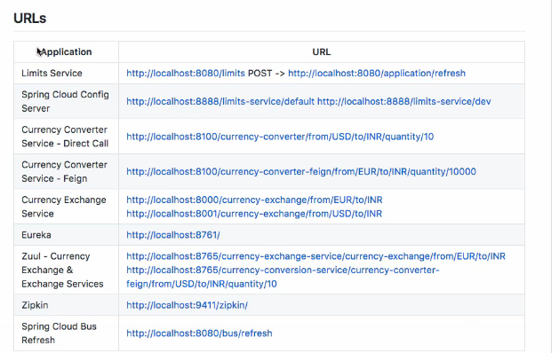

Slide 18
Intro to Limits Microservice and Spring Cloud Config Server
I would not be surprised of hearing that enterprises with more than 100 200 micro services. So each of these micro services have their own configuration.
This configuration might be things like database configuration or any external service configuration or the typical business logic configuration as well.
There are a huge variety of things that would need to be configured for each microService the thing is there are multiple environment for each of these micro services for example the currency conversion service might be having Two QA environments and one each of all others the currency exchange service
might have a lot of load on it and it has four production. environments.And two QA environments.And so what we are talking about is the fact that there are multiple microServices sometimes hundreds of them and for each of these microServices there are multiple environments. And some of these environement might have multiple instances of the same Microservice. So we are talking about managing configuration of a lot of different instances of different micro services managing the configuration individually for each application each environment is a very very difficult thing. And that's where centralized configuration comes into picture spring cloud config server says OK. You put all the configuration for you applications in a git repository. And I would take care of managing the configuration and providing it to the specific microService if limits services says. OK I would want the configuration for dev environment for limits service. The spring cloud conflict server would be able to provide it to it if currency calculation services. OK I would do want the configuration for the third instance of the production environment spring cloud config server would be able to provide a spring cloud config. server would act as the centralized.
Microservice configuration application all that you would need to do is to put all the configuration for these applications for different environment in a git repository and you can connect the spring

Slide 19
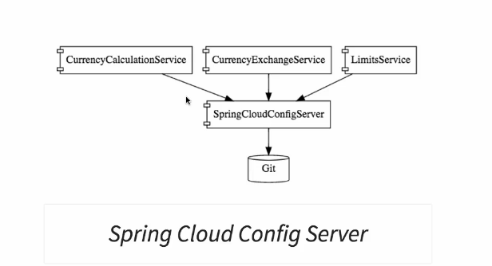

Slide 20
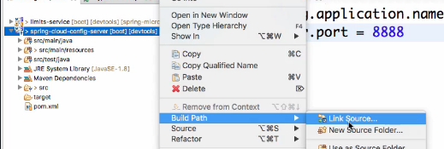
Create git repository
We are using git repository to store configuration file for all microservices we are creating for our application
Steps to connect Spring Cloud ConfigServer to Local Git Repository
1. Create folder on local machine
Mkdir git-localconfig-repo
2. Fire command to initialize git in this folder
Switch to the created folder on command promt (cd git-localconfig-repo ) and type git init. It will create .git folder in it
3. Go the project in eclipse and follow the below steps Right click on project→ build path→ link source→ link created folder here (git-localconfig-repo)

Slide 21
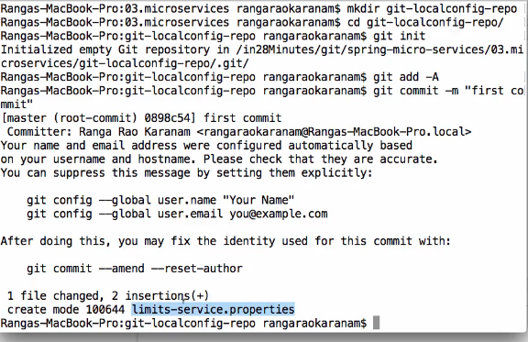
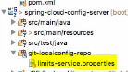
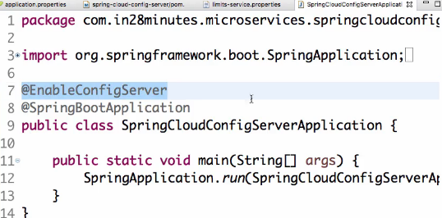
4. Create one property folder in this folder
This property file we are using for the configuration
5. Add this file to local git repository
By command git –A or git –file name
6. Commit the file
Git commit –m “comments for commit”
7. Now we are connecting spring config server application
to git repository
Copy the location by right click on folder →
Set the property in application.property file as
Spring.cloud.config.server.git.uri=file//”location of git repository”
8 Enable below on main class in spring-config-server

Slide 22
Now we are creating configuration file for multiple environment
Create property file like FILE_NAME-dev.property, FILE_NAME-qa.property, FILE_NAME-stage.property
2. FILE_NAME will remain default configuration file FILE_NAME.property
3. Add all files in git repository

Slide 23
Connect Limits Service to Spring Cloud Config Server
Application has his own application.properties file. If we want to connect application to read configuration file from spring cloud we should have to rename file from application.property to bootstrap.property
Give the uri of spring-cloud-config server on bootstrap.property file as
Spring.cloud.config.uri=http//:localhost//uri (url of spring-cloud-config server )
3. Please make sure the application name should be same like configuration file name
Suppose application name is limit-service then property file from git repository would be limit-service.property (for default). And for development environment it would be limit-service-dev.properties, for qa it would be limit-service-qa and so on.
4. If we want to use the qa environment configuration file we should have to set property in bootstrap.property file as shown below
spring.profiles.active=qa
For dev it would be as shown below
spring.profiles.active=dev

Slide 24
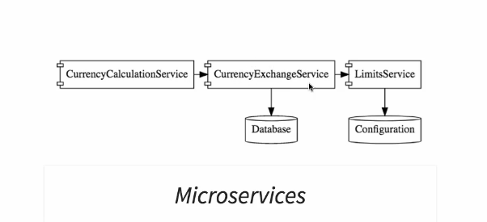
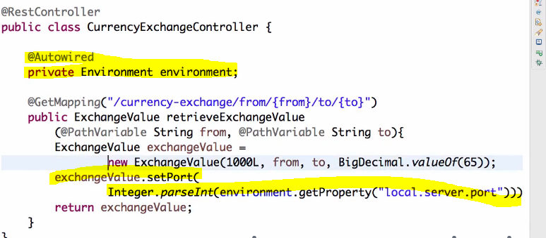
1. Now we are making currency calculation service to communicate with currency exchange service
2. We are creating multiple instance on currency exchange service.
3. To get the port to understand with which instance we are communicating we have created Environment env variable
4. And used as environment.getProperty(“local.server.port”) to get the port. It will return string so we needs to parse it into integer.(This will help to get port dynamically)

Slide 25


How we can make to communicate currency calculation service to currency exchange service
1. Create bean in main class on currency calculation service for rest template
In above code we have used getForEntity of RestTemplate class and passed form and to variable by making map uri variable.
It will return value from the mentioned url and convert it into CurrencyConversion bean.

Slide 26


Feign
Feign provides an abstraction over REST-based calls via annotation, by which microservices can use to communicate with each other without writing detailed REST client code.
Feign removes boiler plate code required to read the read one service from another service
Below are the steps to enable feign in microservice
Add dependencies in the pom.xml
2. Enable the @EnableFeignClients(“Package name where you have to enable”)

Slide 27


Step 3- create one interface as shown below
In above interface we write below
Enable the @FeignClient(name=“Service name which we are calling from this service”, url=“URL of the service”)
Write the same method from another service with pathvariable
For @PathVarible here it is must to pass the parameter (‘from’, ‘to’)
Step 4- Create the object of this proxy interface in the controller class

Slide 28
Step 5- Create one resource in controller from where we can call method from the proxy interface
@GetMapping("/currency-converter-feign/from/{from}/to/{to}/quantity/{quantity}")
public CurrencyConversionBean convertCurrencyFeign(@PathVariable String from,@PathVariable String to,@PathVariable BigDecimal quantity) {
CurrencyConversionBean response =proxy.retrieveExchangeValue(from, to);
return new CurrencyConversionBean(response.getId(),from, to, response.getConversionMultiple(), quantity,
quantity.multiply(response.getConversionMultiple()),response.getPort());
}
If we call the url ("/currency-converter-feign/from/{from}/to/{to}/quantity/{quantity}") the service from currency exchange service will be called and the result will be stored in the CurrencyConversionBean .
And we can return response from here

Slide 29


Setting up client side load balancing with Ribbon
Till now we have established communication between currency conversion service to currency exchange service
And there is one instance of currency conversion service and one instance of the currency exchange service(i.e 8000)
Also for making communication between them we have hard coded the URL part in proxy interface.
In above case if we want make communication between two instance of the currency exchange service we need to implement the ribbon for load balancing
It will help to distribute the load among the multiple instances of the currency exchange service.
Below are the steps to implement it.
Step 1- Add the dependency in the pom.xml file

Slide 30


Step 2- Enable the ribbon client on the proxy interface and pass the name of the service
In this also we will not passing the hard coded url so we can establish the url among the multiple instances.(8000, 8001)
Step 3- Make the changes in application.property file of the currency conversion service to add the multiple instances of the currency exchange service.
currency-exchangeservice.ribbon.listOfServers=http://localhost:8000,http://localhost:8001
Step 4- Create the multiple instance of the currency exchange service.
After this if we hit the currency conversion-convertor-feign service some time it will hit instance of 8000 and sometime it will hit 8001 of currency exchange service to get information. In this way it will distribute the load among the multiple instance of the currency exchange service

Slide 31
Setting up Eureka Naming Server
Till now we have made the communication between one instance of the currency conversation service to two instance of the currency exchange service.
There is one problem in above ribbon service.
If dynamically we have to increase the instances or decrease the instances of the services we have to make changes in the application.property file. Which is not good practice and not possible dynamically
In this Eureka server plays the roll to scale up and scale down the services depend on the need
All instances of the all micro services will be registered on the Eureka naming server
- Whenever an instance of a micro service comes up it would register itself Eureka naming
service this is called Service registration.
- And whenever a service wants to talk to another service let's said the currency calculation Service wants to talk
to the currency exchange service what would it do.
- It would talk to the name server and it would ask the name server what are the instances of the currency exchange service that are currently running. This is called Service discovery.
The two important features of the naming server are service registration and service discovery at startup

Slide 32


Steps to configure Eureka naming
The first thing is we would want to create a component for the Eureka naming server the second thing
is we would need to update the currency calculation service to connect the Eureka naming server the third
thing that's we would want to connect the currency exchange application also to talk to the Eureka naming
server.
The last thing we would do is configure ribbon.
Ribbon is actually currently installed in the currency calculation service.
Once the currency exchange service instances register with the naming server.
We would then use the ribbon to find those details from the naming server.
That would be the last step before we would be able to use the naming.
Step 1- Create the spring boot project naming Netflix-eureka- naming-server with below dependencies
Step 2- @EnableEurekaServer in the main class
Step 3- add some properties in the application.property file like server.port and application name
eureka.client.register-with-eureka=false
eureka.client.fetch-registry=false

Slide 33


Step 4- If we hit the url ther browser for eureka application we will get one UI as below (url will be like localhost:portnumber)
Which shows the instances registered with the eureka naming server
Step 5- Connect currency calculation service and currency exchange service and limit service to the eureka naming server
Step 6- Connect currency calculation service to eureka
1. Add dependency in pom.xml of currency calculation service of eureka client

Slide 34



2. In the main class of the currency calculation service enable the @EnableDiscoveryClient
3. Set the property in property file of currency calculation service as below
eureka.client.service-url.defaultzone=http://localhost:8761/eureka (URL of the Eureka server).
4. Once we restart the currency calculation service and hit the url of Eureka server, you will get below screen with currency calculation service is registered with eureka naming server

Slide 35
Step 7 - Connecting Currency Exchange Microservice to Eureka
Same step as above we can follow to Connecting Currency Exchange Microservice to Eureka
Step 8- We have hard coded the instances of the Currency Exchange service in the currency calculation service. In this steps we are going to remove the hard coded instances of the Currency Exchange service.(Distributing calls using Eureka and Ribbon)
Remove the property from property file of currency calculation service.
#currency-exchangeservice.ribbon.listOfServers=http://localhost:8000,http://localhost:8001
After the restarting all the services all the services will get registered with the eureka server automatically
The important thing for us to understand right now is that without configuring the URL of the currency
exchange service inside the currency calculation service we are able to get the currency calculation
service to talk to the currency exchange service the way it's happening is ribbon asks the naming server
it ask OK what are the instances of the currency exchange.
service and it is gets a list back of instances of the currency exchange service .
- Even if we create multiple instances of the services it will automatically register with eureka naming server and we not need to hard code it into the property files

Slide 36

Introduction to API Gateways
- Common Properties we can implement using API getways
Authentication, authorization and security- We can check each request against this parameter
Rate limit- We can limit the user to call the services. It could be 100, 350 times
Fault Tolerance- If any service down we can give default response back
Service aggregation- Let's say there is an external consumer who wants to call 15 different services as part of one process.
It's better to aggregate those 15 services and provide one service call for the external consumer.
So these are kinds of features that are common across all the micro services and these are features
these are features
which are implemented at the level of API gateways instead of allowing micro services to call each other directly
what we will do is we would make all the calls go through a API gateway and the API gateway would take
care of providing common features like authentication making sure that all service calls are logged making
sure that the rate limits are at the two and making sure that these services are fault.tolerence.
The API gateways can also provide aggregation services around multiple services because all calls get routed through the API gateways it a gateways.

Slide 37

Setting up Zuul API Gateway
Below are the steps to configure zuul api gateway
First we would want to create a component for these zuul API gateways server
2. Decide what should it do when it intercepts a request. So when a currency calculation service is called to currency exchange services intercepted what should this Zuul API gateway do you need to implement that.
3. third part is to make sure that all the important requests are configured to pass through the Zuul API gateway.
Step 1- Create zuul api component,
1 .for this we have to create one spring boot project naming Netflix-zuul-api-gateway-server with dependencies below
We need Eureka Discovery to be register zuul application on eureka server
2. In main class of zuul api gateway we have to enable @enablezuulproxy and enable @EnableDiscoveryclient for Eureka registration
3. Follow all the steps required to register application on Eureka server. (We already done for configuration of eureka naming server)

Slide 38
Step 3- Implement some functionality in the zuul api gateway. In this project we are going to implement logging for all the services
Create a class for ZuulLoggingFilter which extends zuulfilter
Implement all the unimplemented methods from zuulfilter
methods are i)shouldFilter()- decide filter or not- true for filter and false to not filter
ii) filterType()- Tell when to be filter happen i.e before request execute or after request execute
iii) run()- Return type is Object, in this method we write actual logic
iv)filterOrder()- it decide the order of the filter
Step 4- Now we have to execute the request through zuul api gate way. Suppose we have execute the request of currency exchange service through zuul api gateway we have to construct url as below
{url of zuul api gateway}/{name of the application}/{url of the request}
http://localhost:8765/currency-exchange-service/currencyexchange/from/EUR/to/INR
After excecuting above url we will get the log on the console for the request

Slide 39


Setting up Zuul API Gateway between microservice invocations
Suppose if we want to make communication between currency calculation service to currency exchange service through zuul api
We can do the following steps
Step 1- we can make currencyExchangeProxy to communicate with zuul api gate way we will remove the currency exchange service name from feign annotation and put the zuul api gate way application name
Step 2- Append the service name to the get mapping url as below

Slide 40
After executing the currency conversion service call will go the currency exchange service thorough zuul api gateway
This request will print the log for both the application. That is for currency conversion service as well as currency exchange service
If we want to execute the currency conversation service through zuul api gate way we can construct the URL as below
{url of zuul api gateway}/{name of the application}/{url of the request}
http://localhost:8765/currency-conversion-service/currencyconverter-feign/from/USD/to/INR/quantity/10
This request will print the log two times
One for currency conversation service and second for currence exchange service.

Slide 41
Introduction to Distributed Tracing
In the previous steps we saw that with the introduction of micro services calling of services becomes complex. There are multiple call chains. So the currency calculation service would call the currency exchange service and this would be intercepted by an API gateway. Sometimes we even use the API gateway before calling the currency calculation service. Let's say there is a small defect. This service is not really working fine and you would want to debug it. How do you do that. We'll look at the look at the currency calculation service do we look at the currency exchange service or We'll look at the API gateway. How do you find out where the defect is and how do I know what is happening in total with that specific request. One of the most important things with implementing a micro services architecture is we would need to have something called distributed tracing. I would want one place where I can go and see what happened with a specific request. I would want to have one single centralized location where I can see the complete chain of what happened with a specific request. This is especially important because there are variety of components that are involved. When we talk about the typical micro service architecture until now we looked at that different. micro services we talked about API gateways we talked about naming server we talked about configuration server. I want n number of components are involved. If you want to solve a problem and if you want to debug a problem through this you would need a centralized kind of information. And that's where this distributed tracing comes into picture. There are a variety of options that are present for distributed tracing. What we'll do in this section is to use something called Spring cloud sleuth with Zipkin. One of the important things is to assign a unique ID to a request. So let's say a request is going through a set of application components. It's going through the API gateway to the currency calculation service. Are going through the API gateway and the currency exchange service how do I identify that this request is the same one the only way I can identify that is by assigning ID to this request and that's what spring cloud sleuth. So S L E U T H spring cloud sleuth would assign a unique ID to a request so that I can trace it across. Components zipkin is what we call a distributed tracing system. What we would do is all the log from all these services we would put it in MQ we would use rabbitMQ. And we would send it out to the zipkin server where it is consolidated. And we would be able to look through the different requests and find what happened with the specific request.

Slide 42


Implementing Spring Cloud Sleuth
We are implementing spring cloud sleuth to trace all requests centrally
To implants these we have to do these two steps in the application where we have to implements Spring Cloud Sleuth.
Step 1 add the dependency in pom.xml
Step 2 Add @Bean in the main class with method defaultSampler() which has return type AlwaysSampler as shown below
In our example we have added Spring Cloud Sleuth in the zuul api gateway, currency conversation service and currency exchange service application

Slide 43

- Now we are going to check the implementation of Spring Cloud Sleuth. For this we are going to insert some log statement in the all of the that three application, that is in the zuul api gateway, currency conversation service and currency exchange service application
Then we will restart all these application
Will hit the request for these applications
After running the request it will print something (logs) on there respective console with ID assigned to it(For all these three application we have to select different console in the eclipse which is little tricky). As shown below
In above image log is printed for currency conversation service with highlighted id
As this log is not generated centrally we are using Distributed Tracing with Zipkin. In below image there is different console for different application

Slide 44

Introduction to Distributed Tracing with Zipkin
In above diagram all the request will pass through Spring Cloud Sleuth has id to it.
If we are invoking currency calculation service internally it invoke multiple request like api gateway, currency Exchange service, currency conversation service.
It would be difficult to trace the log for there transection.
Spring coude sleuth will assign the id to each log of the request and put this log to queue the RabbitMQ.
Zipkin distributed tracing server will use the log from rabitMQ to track the request.
Zipkin distributed tracing server use the database to store the logs

Slide 45
Installing Rabbit MQ
We have to follow some steps to install Rabit MQ which I think we canget on google easily
Setting up Distributed Tracing with Zipkin
Below are the steps to setting up Zipkin
Step 1 - Download the zipkin quickstart from the google it will download a jar file
Step 2- Place this jar in local machine
Step 3 – to the command prompt and go to the location where we have kept the jar file for zipkin server from command from
Step 4- Execute the jar file using the command java –jar “zipkin jar file name.jar” To excute this jar file it is must to have jave version greater than 8.
This will start zipking server after some time
Step 5- After starting zipkin server you can hit the localhost:9411/zipking/ it will one one UI in the browser
Step 6- Make the communication between Rabbit MQ and zipkin server using two separate commands on windows
Set RABBIT_URI=amqp://localhost and java –jar “zipkin jar file name.jar” Make sure rabit mq server is up and running

Slide 46

Connecting microservices to Zipkin
To make communicate all the micro services with zipking tracing server we have to add dependency for zipkin and for Rbbit MQ in pom.xml of applications of all the microservices

Slide 47


Using Zipkin UI Dashboard to trace requests
After adding dependencies in all the applications we will restart these application in the sequence
After restarting the application we will hit the url for currency conversation service (Which is communcatioting like→ Zuul api gateway→ currency exchange service)
After as we hit the URL for zipkin server (localhost:9411/zipkin/) one UI will come as below which will show all the applications connected to zikin server in drop down list
We can select one of the application and click on find traces. This will show window as below which is describing how the request is flowing. If we click on any application below one window for details(response status, status code).

Slide 48
Understanding the need for Spring Cloud Bus
If we made the changes in the property file stored in the git the changes is not reelecting to the application even if we commit that changes
To reflect this changes we have to run below post request in the browser/ postman
To run above request we have to set below property in the property file
After refreshing the application the changes will reflect from the git.
After each change we have to run refresh post request
- In the example that we are talking about, we had two instances of the Limits Service.
But let's assume there are a hundred instances of the Limits Service which are running in parallel. So, to refresh the configuration from the Git repository, I need to invoke 100 URLs and that's not really good because the number of Limits Service increase the maintenance headache for Limits Service keeps growing and imagine this in a world where there are a hundred microservices with 10 or 15 instances of each. Every time you make a change in the configuration and you want the configuration to reflect in the microservice, you don't know what to call 1000 URLs. That's where Spring Cloud Bus provides us a solution. We can have one URL for all instances and once you hit that URL, all the instances of the microservice would be updated with the latest values from the Git configuration.

Slide 49

Implementing Spring Cloud Bus
Add the dependency in the spring clude config and in limit service (which is reding property file from spring cloud config application )applications pom.xml
After adding the dependencies restart all the applications.
Then run the below post url
Which will refresh configuration for all the instances of the microservices at a time of the microservice.
- How is this happening? All this magic is happening because of something called Spring Cloud Bus.
In this specific instance, we are running the Spring Cloud Bus over RabbitMQ. The way the Spring Cloud Bus works is at application start up, all the microservice instances register with the cloud bus. So, if Limits Service has three different instances, then instance1. instance2, and instance2, all of them register with the bus. When there is any change in configuration, when the refresh is called on any of these instances, the microservice instance would send an event over to the Spring Cloud Bus and the Spring Cloud Bus would propagate that event to all the microservice instances that are registered with it. That's how all of the instances would upgrade its configuration from the Spring Cloud Config Server. Think about Spring Boot is as soon as we add in the right dependencies, everything is auto-configured for us.We have RabbitMQ running in the background, Spring Boot detects that and it sees that there is a amqp dependency in the class path, it would automatically configure a connection to RabbitMQ.

Slide 50

Fault Tolerance with Hystrix (Works like exception hadeling in java)
instead of having one big monolith application. We have a number of smaller micro services interacting with each other. It is possible that a couple of my services might be down some some where in the entire architecture. If any of these micro services are down then they can pull down the entire chain of micro services that are invoking them or that are dependent on them. And that's one of the risks of micro services architecture. For example the currency calculation service depends on the currency exchange service and the currency exchange service depends on the limits service. For example in that case if the limit service is down then both these services also will not be available.
And that's not good situation to be in if one of the micro services goes down all the other micro services also go down along with it your micro services have to be better than that. And that's where fault tolerance of your micro services comes into picture. One of the things that you should always consider when a micro service is being created is what if some functionality does not work as expected. Let's say the limits service depends on some of the service and that service is not available then can limit service providers default graceful behavior the functionality might not be perfect but at least the limits service does not go down it at least gives a good enough response back to the currency exchange service so that it can go ahead and do the work it needs to do. It would prevent the entire chain from going down. Hystrix framework helps us to build fault tolerant micro services.
Step to add hystrix
1. Add the dependency in pom.xml
2. in the main class of the application enable the hystrix by putting annotation on class @Enablehystrix

Slide 51

In the controller class write a method which has @HystrixCommand annotation which has argument fallbackmethod=“methodname”
Create one method which will execute if in the method(anoted with @HystrixCommand) any exceptions occurs.
This method will return default meaning full message.

